Slide 1
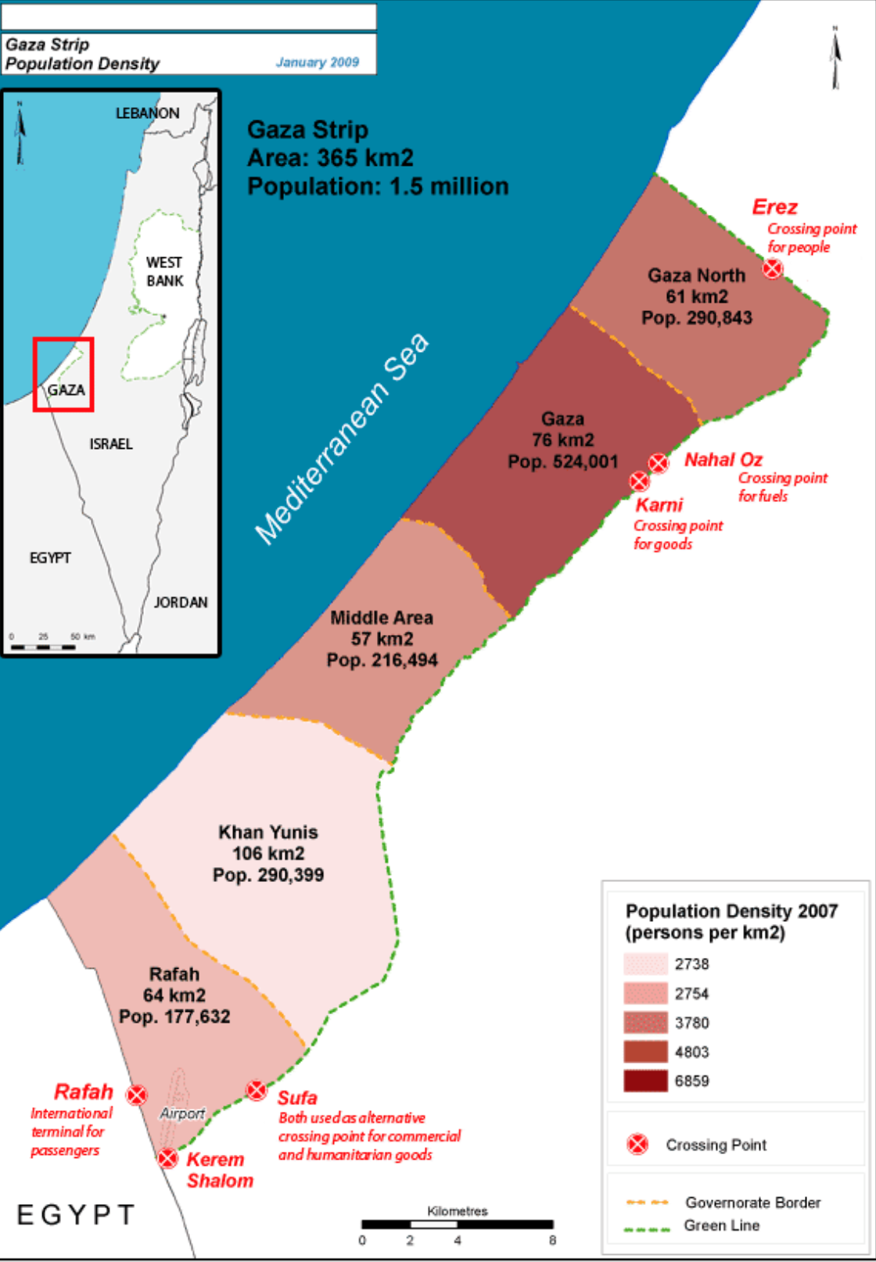

Health Updates for Gaza
Dec 28, 2023

Slide 2
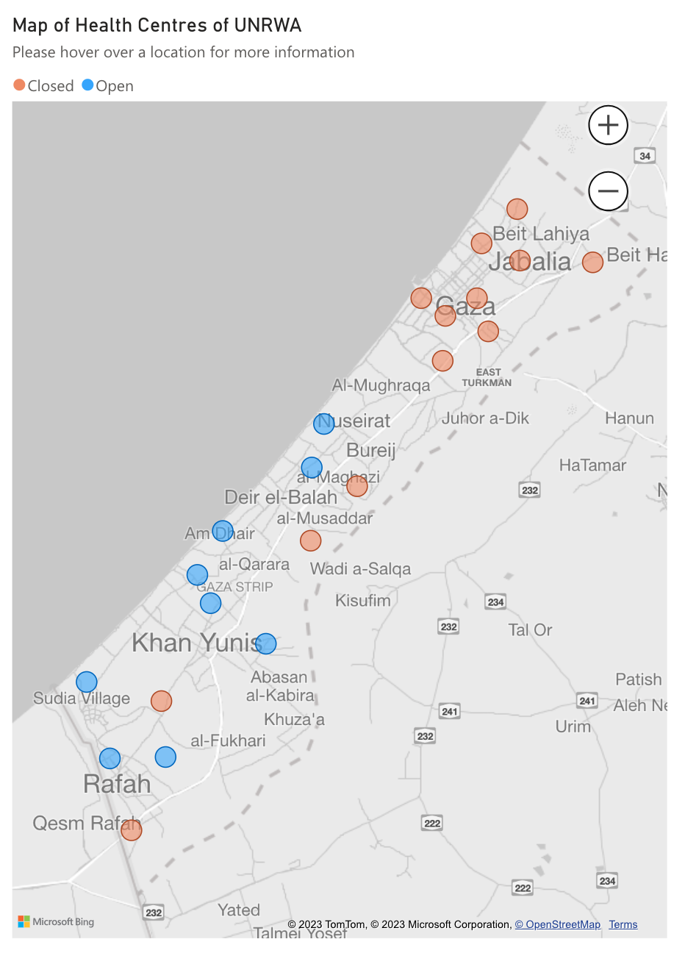
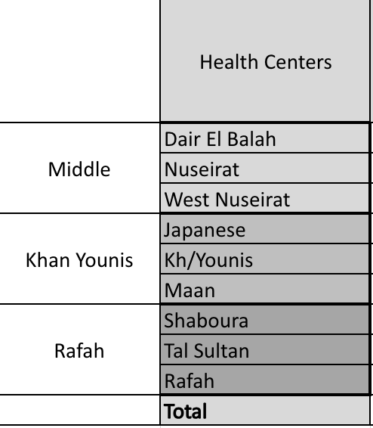
Health Services
Before Oct 7: 22 Health Centers (HCs) supporting 1.3 million refugees (total pop. of Gaza 2.2 million
Others served by Ministry of Health (MoH)
Dec 28, 2023:
8 HCs – pop. catchment area unknown due to displacement (Maen HC is closed).
3 HCs in Rafah Area provide afternoon shifts for outpatient services from 1:00pm to 4:00pm.
80 shelters providing health services supported by 90 medical teams, serving 1,590,912 persons: average pop per shelter: 16,401 (7,338 – 42,706)
16 shelters with no medical teams due to security situations
6 in Khan Younis and 10 in Middle area
4 UNRWA contracted NGO hospitals: partially functional

Slide 3
Number of Health Staff Working
Before Oct 7: had approx. 1,000 health staff
 | Gaza North | Gaza | Middle Area | Khan Younis | Rafah | TOTAL
# of functioning HCs |  |  | 3 | 2 | 3 | 8
# of working Health staff |  |  | 127 | 85 | 194 | 406
# of Shelters
# of medical teams |  |  | 22 | 33 | 34 | 89
# of staff in shelters |  |  | 68 | 76 | 103 | 247
TOTAL health staff working |  |  | 195 | 161 | 297 | 653

Slide 4
Number of Consultations/day
Before Oct 7: had approx. 15,000 consultations per day overall in all HCs; there were no shelters
Now there are about 23,000 medical consultations/day
In HCs: 11.8% of consultations are for non-refugees
 | Gaza North | Gaza | Middle Area | Khan Younis | Rafah | TOTAL
HCs |  |  | 3,991 | 3098 | 5,709 | 12,798
Shelters |  |  | 3,085 | 3,542 | 3,499 | 10,126
TOTAL consultations/day |  |  | 7,076 | 6,640 | 9,208 | 22,924

Slide 5
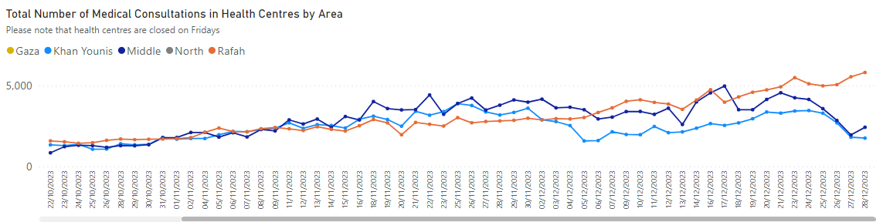
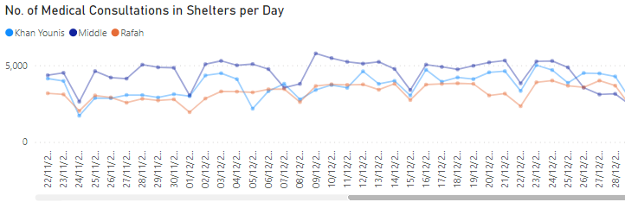
Number of Consultations/day cont
Notes:
8,886 5,620 6,106 20,612

Slide 6
Number of Patients/ Medical Officer (MO)/day
# medical consultations/medical officer:
HCs: before war was 55 patients/MO/d
Shelters: didn’t exist before Oct 7
Sphere Std: max 50 patients/MO/d
 | Gaza North | Gaza | Middle Area | Khan Younis | Rafah | Average | Range
HCs |  |  | 154 | 182 | 110 | 138 | 100-195
Shelters (data for 81 shelters) |  |  | 91 | 111 | 100 | 100 | 30-214

Slide 7
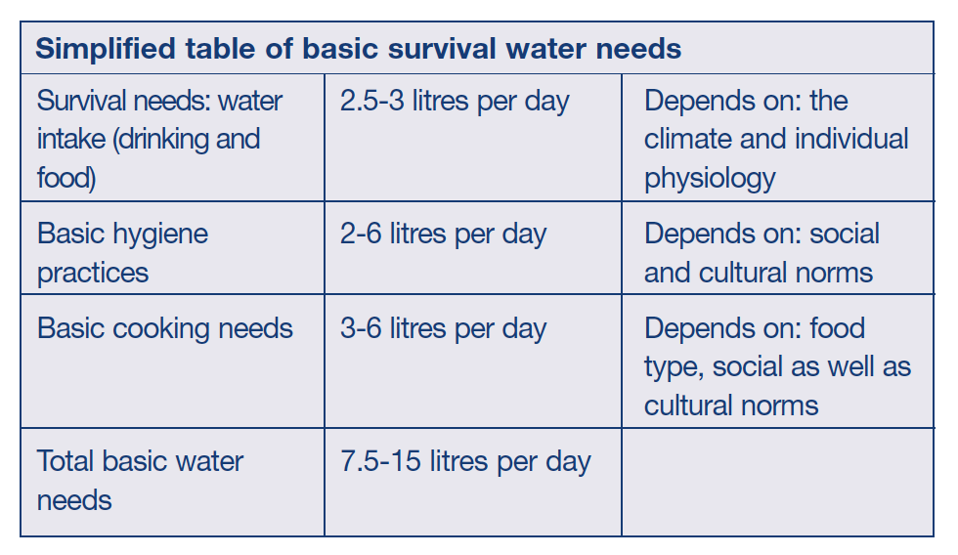
Water and Sanitation in Shelters
Currently on average for the 96 shelters there is 8.8 liters/person/day (L/p/d)
This comprises of 1.6 L/p/d of potable water and 7.2 L/p/d for domestic use
Sphere Std: survival 7.5; minimum 15 L/p/d
 | Gaza North | Gaza | Middle Area (av) | Khan Younis (av) | Rafah (av) | Overall Average | Range
# persons/toilet |  |  | 534 | 367 | 653 | 516 | 0 – 2,029
# persons/shower |  |  | 5,007 | 1,581 | 2,745 | 2,634 | 0 – 3,056
Sphere Stds:
max 20 persons/toilet
max 20 persons/shower (IOM )

Slide 8
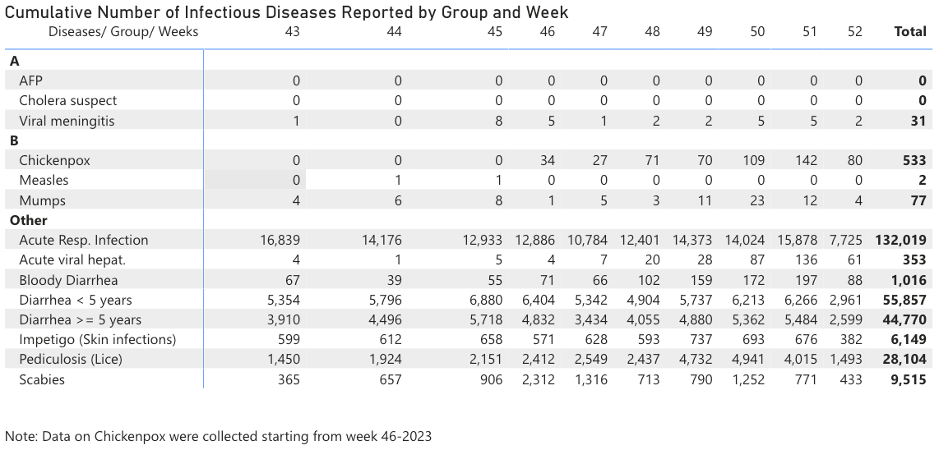
14 Diseases of Epidemic Potential (14DEP)

Slide 9
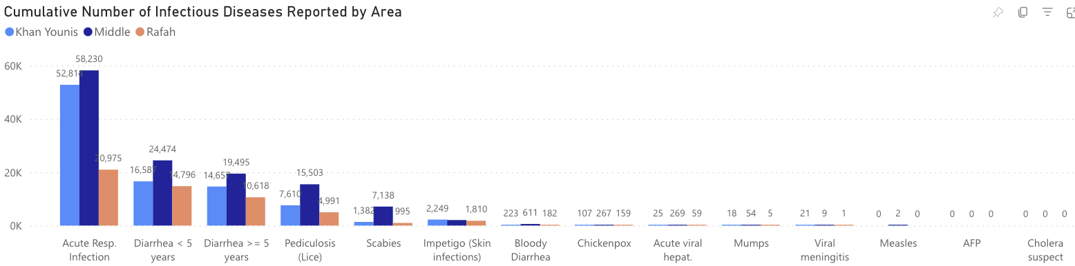
14 Diseases of Epidemic Potential (14DEP)

Slide 10
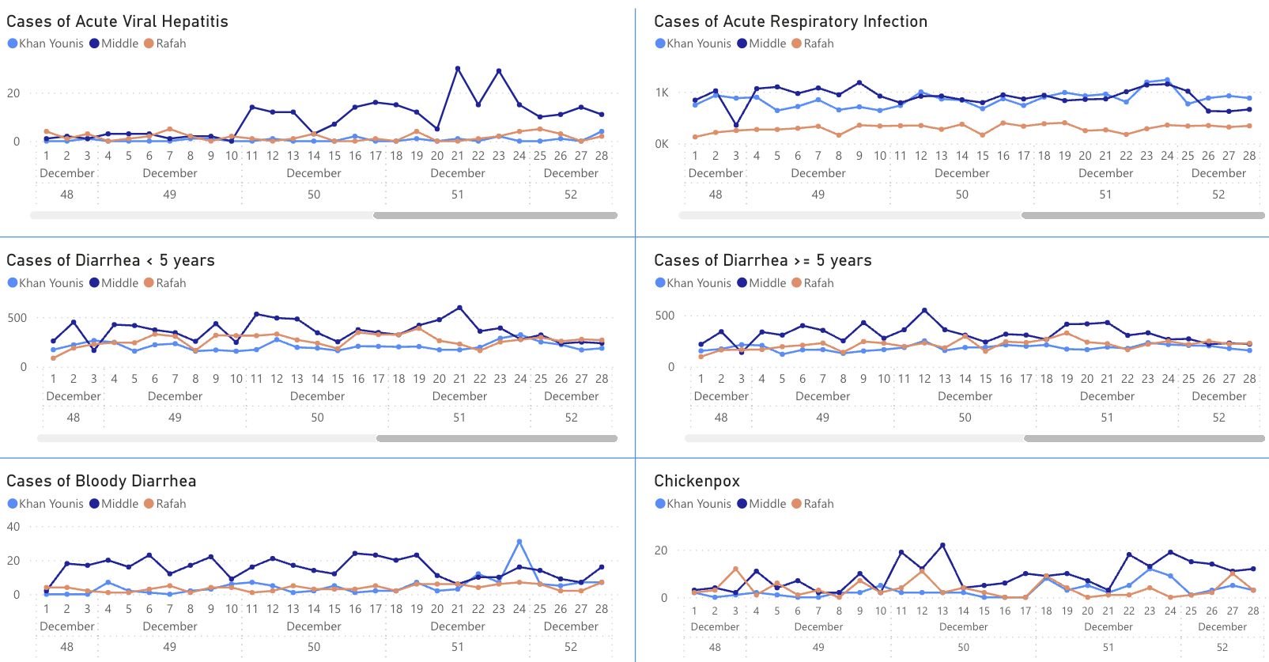
14 Diseases of Epidemic Potential cont

